Slide 1
Food Science
Student Name:
Class: Target Level:

Slide 2
Why do we cook food?
To make food easier to digest
To make food look and smell and taste better
To make food safer to eat
To prevent spoilage and increase its keeping qualities

Slide 3
Cooking Methods
There are 2 main methods:-
Cooking in water or fat (moist heat)
Cooking in an oven (dry heat)

Slide 4
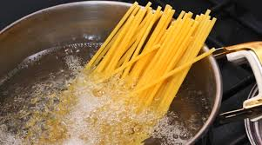
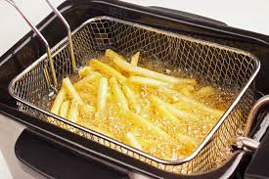
Cooking in water
Simmering/Boiling
Steaming
Poaching
Pressure cooking
Stewing/Braising
Blanching
Cooking in fat
Shallow frying
Deep frying
Stir frying

Slide 5
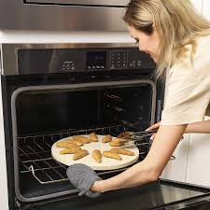
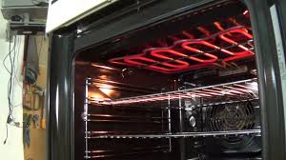
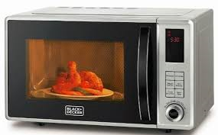
Cooking with dry heat (oven/grill)
Baking
Roasting
Casseroling
Grilling
Microwaving

Slide 6
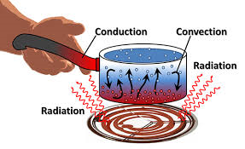
Methods of Heat Transfer
Name the methods of heat transfer (1-3)
Describe the heat transfer (4-5)
Give food examples of the heat transfer method (6-7)
For a recipe of your choice, describe ALL heat transfer taking place (8-9)

Slide 7
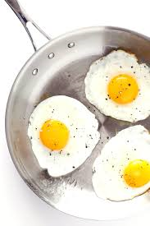
Conduction
Conduction
Heat is conducted through solid objects.
For example: frying an egg
The metal frying pan heats up because the molecules in the metal vibrate from the heat.
Heat travels along a metal rod by conduction.

Slide 8
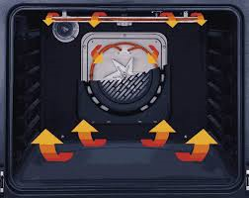
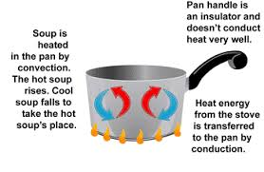
Convection
Heat moves through liquids and gases by convection currents. For example: boiling food or cooking in the oven.
When liquids or gases are heated, the part closest to the heat source warms first and rises. This is replaced by cooler parts of gas or liquid. This is then heated until the water reaches boiling point.
This is called a CONVECTION CURRENT.
In the oven convection currents makes it hotter at the top & cooler at the bottom (this gives different zones of heat). Useful to cook a variety of foods at different temperatures.

Slide 9
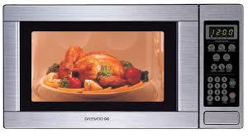
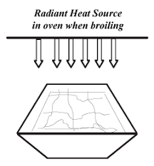
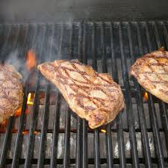
Radiation
Transfer of heat by waves which travel through space. If something gets between the heat source and the food, the heat is stopped – it will not get through or round the object. Two examples of radiation are infrared (the grill) and microwave.

Slide 10
Most foods are cooked by a combination of heat transfer methods.
For example, boiling potatoes uses conduction from the heat to the pan, and convection currents in the water.
To do - When we cook cakes, list all the heat transfer methods and where they are used.

Slide 11
Most foods are cooked by a combination of heat transfer methods.
For example, boiling potatoes uses conduction from the heat to the pan, and convection currents in the water.
To do - When we cook cakes, list all the heat transfer methods and where they are used.

Slide 12
Which fact is wrong?
Most foods are cooked by a combination of heat transfer methods.
Convection occurs in liquids
Conduction occurs in the oven
Radiation travels in straight lines and cannot go round or through things.

Slide 13
Which fact is wrong?
Most foods are cooked by a combination of heat transfer methods.
Convection occurs in liquids
Conduction occurs in the oven – wrong. Convection currents are the main method of heat transfer in the oven. But convection will happen in the baking trays which are put into the oven!
Radiation travels in straight lines and cannot go round or through things.

Slide 14
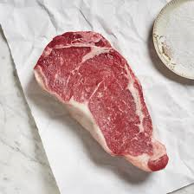
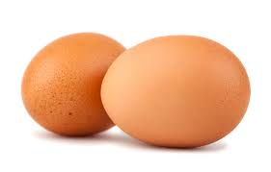
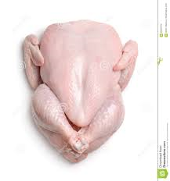
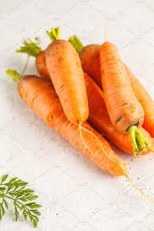
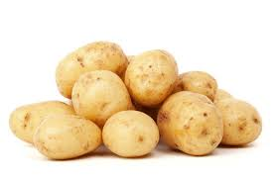
1. How can I be cooked? 2. Describe the heat transference and the suitability to the food item.

Slide 15
Quiz.
The answer spells out a method of cooking. Name the method and 3 foods you can cook that way.
Which is a moist method of cooking? A Grill S Poach C Bake | 2. Which is a dry method of cooking? U Steam L Pressure cook T Bake | 3. In a grill where does the heat come from? O Top & bottom R Bottom E Top | 4. Which method of cooking does not brown food? I Baking T Grilling A Microwaving
5. Which method is better for reducing fat intake? M Stir frying A Deep frying T Shallow frying | 6. Which method kills most vitamin C? I Boiling A Steaming | 7. Which method is quickest? I Stewing N Pressure cooking R Casseroling | 8. Which meal uses most energy R Beans on toast P Cheese on toast G Boiled egg & toast soldiers

Slide 16
Quiz.
The answer spells out a method of cooking. Name the method and 3 foods you can cook that way.
Which is a moist method of cooking? A Grill S Poach C Bake | 2. Which is a dry method of cooking? U Steam L Pressure cook T Bake | 3. In a grill where does the heat come from? O Top & bottom R Bottom E Top | 4. Which method of cooking does not brown food? I Baking T Grilling A Microwaving
5. Which method is better for reducing fat intake? M Stir frying A Deep frying T Shallow frying | 6. Which method kills most vitamin C? I Boiling A Steaming | 7. Which method is quickest? I Stewing N Pressure cooking R Casseroling | 8. Which meal uses most energy R Beans on toast P Cheese on toast G Boiled egg & toast soldiers
S | T | E | A | M | I | N | G

Slide 17
Examination Questions
We are encouraged to eat fewer fried foods. Suggest
suitable alternative methods to frying for cooking the following
foods (justify your answer):
a)Sausages
b)Eggs
c)Beef burgers
d)Potatoes
2. We are encouraged to reduce the amount of energy (gas/electric) we use when cooking meals.
Discuss how this can be done in the home. (4 marks)
http://www.wikihow.com/Reduce-Energy-Use-While-Cooking

Slide 18
Cooking Methods Homework
Answer the following questions.
Cooking food make sit more palatable. Is this true or false?
What is the main heat transfer method when boiling food?
How can cooking methods be classified?
Name three types of heat transfer.
Write about the last cooked meal you ate. Name the cooking methods used and the heat transfer methods involved.

Slide 19
Proteins and Enzymic Browning
Proteins are made from lots of amino acids joined together by chemical bonds. These chemical bonds create the 4 structures of protein.
Denaturation occurs when

Slide 20
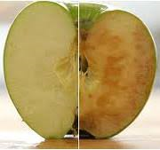
Proteins and Enzymic Browning

Slide 21
Amino Acids
Amino acids are the building blocks of proteins.
They start off in tight coils and unravel or DENATURE when the food is cooked

Slide 22
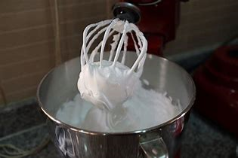
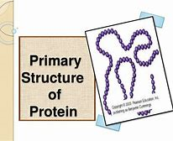
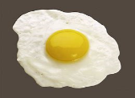
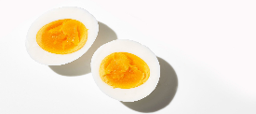
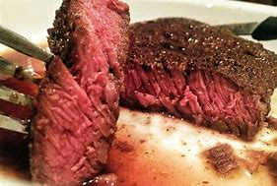
Proteins
Aeration / foaming
Amino acids unfold, trap air and re-bond to form a foam with air trapped inside. In meringue and cakes.
Coagulation
Heat causes proteins in egg, meat & fish to coagulate (go firm). Acid can also do this – cheese making where acid is added to milk to form curds and whey.
Maillard Reaction
A chemical reaction between amino acid and sugars which occurs during roasting, baking, grilling and frying of foods. It gives a brown colour and a pleasant smell.

Slide 23
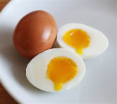
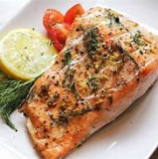
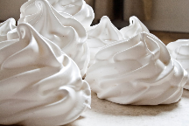
Denaturation of Proteins
Heat
pH
Enzymes
Mechanical actions
Denaturation happens when the structure o amino acids are altered when chemical bonds are broken.
Denaturation can be caused by heat (cooking), acid, enzymes & mechanical action
Complete the table from pg 42

Slide 24
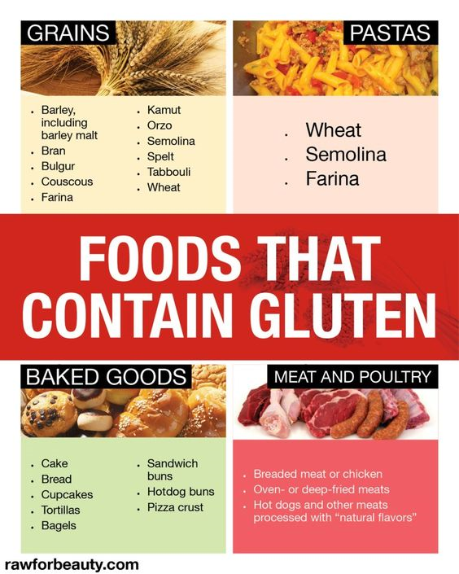
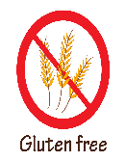
Gluten
A protein in…………
When mixed with
water and kneaded
it becomes elastic &
allows bread, cakes
Pastry etc to rise.
Coeliac’s are intolerant to it and must avoid it to avoid stomach cramp, sickness and diarrhoea.

Slide 25
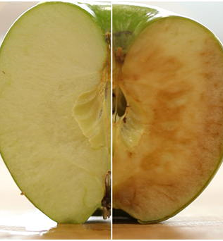
Proteins & Enzymic Browning
Enzymic browning occurs on the surface of cut fruit & vegetables.
It happens due to cell enzymes reacting with air (oxidation).
How can enzymic browning be prevented?

Slide 26
Oxidation
Oxidation is a reaction that turns fruit & beg brown when enzymes are exposed to the air.
It causes browning & discolouration.
Oxidation can be reduced during preparation and cooking by:

Slide 27
Quick Test:
What causes the browning of cut fruit & vegetables?
___________________________________________
What is the term used to explain the way heat changes the texture of egg protein?
_____________________________________________

Slide 28
Practice Questions:
Q4. Name the 4 ways that protein foods can be denatured:
Q5. in what way does the texture of the quiche filling change during baking?
__________________________________________________________________________________
Q6. why does the texture of the quiche filling change during baking?
__________________________________________________________________________________
Q7. what is the name of the protein in wheat flour? __________________________
Q8. in what way is the protein content of string flour different to plain cake flour? __________________________________________________________________________________
Q1. Shelf life, digest , variety, microorganisms, keep quality
Food is cooked to:
Make it safe to eat by destroying_______________
Help extend___________________ and____________________
Improve ______________________ in the diet.
Make it easier to________________
Q2. Name 3 methods of heat transfer: _____________
_______________, ___________________
Q3. Name 2 examples of each cooking method:
Water-based _____________ & ______________
Dry cooking ______________&_______________
Fat based ________________&_______________

Slide 29
Q9. state two actions that are required for wheat flour to form gluten.
Q10. gluten is formed from two proteins in wheat; glutenin is one, what is the other protein? ___________________________
Q11. what is the term used to explain browning in foods not as a result of either dextrinization or caramelisation?
____________________________________
Q12. explain one way to prevent enzymic browning when using apples.
____________________________________________________________________________________________________________

Slide 30
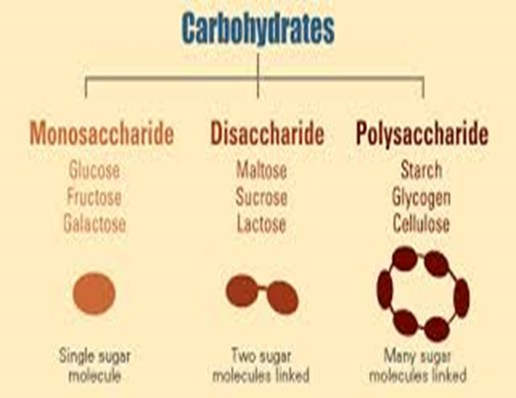
Carbohydrates
One unit
Simple carbs
Quick release energy
e.g. Fructose
2 units
Quick release energy
e.g.
Sucrose (normal sugar)
Lactose (milk sugar)
Many units
Slow release energy
e.g.
Starch
Pectin
Fibre (soluble/insoluble)

Slide 31
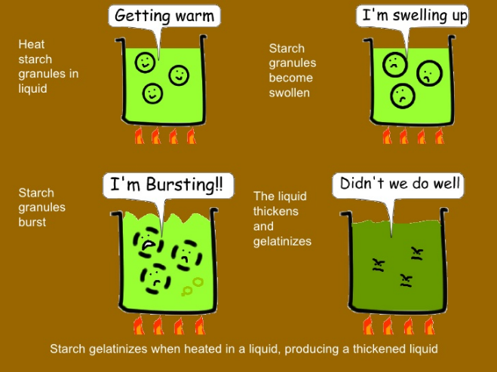
Gelatinisation
occurs when starches (from wheat flour / corn flour) thicken liquids when heated (i.e. making a sauce)
Starches thicken at 100C & need to be stirred (agitated) to avoid lumps.
The viscosity or thickness of the sauce depends on the ratio of flour : liquid used

Slide 32
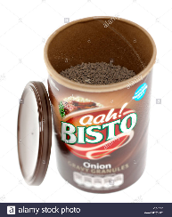
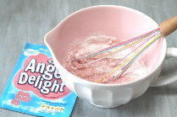
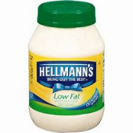
Modified Starch
Food starches are modified to make them easier to use in certain recipes. Modified starch has many uses in food products:
Making a product easier to dissolve on cold water or milk for instant gelatinised recipes
Serving as a fat substitute for low fat foods.
Acting as an emulsifier & stabilizer for salad
Dressings to keep oils from separating
Forming a hard shell on jelly beans
Producing foods with longer shelf lives

Slide 33
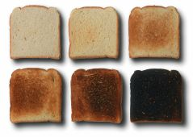
Dextrinisation
If starch is subjected to dry heat, it breaks down to form dextrins.
This process is called dextrinization. Dextrins are mainly brown in colour and dextrinization is partially responsible for the browning of toasted bread.
It’s a chemical reaction, which turns this into this
Where else do you
See dextrinization?

Slide 34
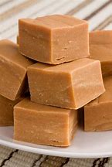
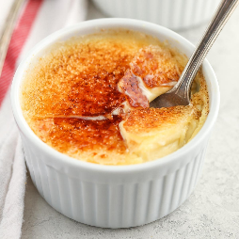
Caramelisation
Caramelisation causes sugar to change colour & flavour in dry or moist heat.
It turns baked goods containing sugar brown & changes the properties of sugar - it turns into syrup.
Caramelisation is known as ‘non-enzymic browning’ e.g. frying onions, roasting potatoes, making a crème brulee or crème caramel
Browning is often used as an indicator of
Adequate cooking e.g. ‘cook until golden
Brown.

Slide 35
Carbohydrates Test
The function of starch in thickening a solid / liquid is known as gelatinisation / caramelisation.
For a sauce to thicken it needs to be chilled / heated and also stirred / sieved to ensure a smooth sauce.
A sauce should be heated to a setting / boiling point to make it thicken.
As bread is toasted dextrins are formed. How does dextrin affect the colour, flavour & texture of the toast?
Colour: __________________________________________________
Flavour:__________________________________________________
Texture:__________________________________________________

Slide 36
Carbohydrates test cont……..
What is the scientific term for the effect of dry heat on starch?
_________________________________________________________
Dextrins attract moisture from the air. What is the scientific term for this? ______________________________
How does this process affect the quality of toast?
__________________________________________________________
What term describes thickening a sauce using starch? _____________
What sort of heat transfer commonly causes dextrinization? ________________________________________________________

Slide 37
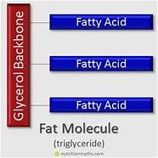
Fats

Slide 38
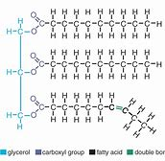
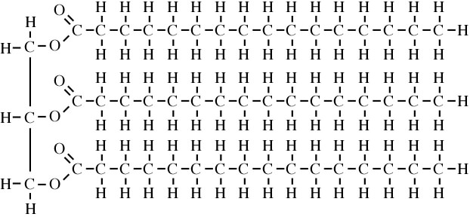
Unsaturated – has double bond, Hydrogen missing
Usually from vegetable sources – olives. seeds
Can lower cholesterol so reduce chance of heart disease
Liquid at room temp. – the missing Hydrogen gives space for movement (flow).
Saturated – no double bonds, no Hydrogen missing
Usually from animal sources (lard, butter, meat, dairy)
Raise cholesterol so increase chance of heart disease.
Solid at room temp.

Slide 39
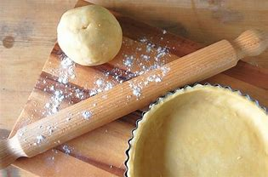
Fats & Oils: Shortening Properties
Shortening properties of fats:
Shortening is a process using fat that creates a characteristic short, crumbly texture as seen in shortcrust pastry & shortbread.
It is made by rubbing the fat into flour.
Fat coats the flour grains, preventing gluten development.
The cooked texture is crumbly or ‘short’
When cooked, the flour absorbs the fat, the gluten sets & the pastry is rigid rather than pliable & turns golden brown.

Slide 40
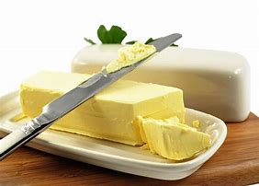
Fats & Oils: Plasticity
Plasticity means the ability of fat to change its physical structure & appearance over a range of temperatures (e.g. from a solid to a liquid).
Cold fats are solid & firm, at room temp they become soft & spreadable, warmed fats melt & become runny.
Plastic fats such as butter or margarine can be used for spreading, rubbing-in, creaming, melting-method cooking or muffins.

Slide 41
Fats & Oils: Aeration
Aeration helps products have a light & airy (open) texture.
Fats aerate mixture during beating or creaming with sugar.
Aeration increases the volume of a product by incorporating air.
Beating, whipping, creaming & whisking are methods that help aeration.
During preparation of a creamed mixture: the fat & sugar trap air (aeration), the mixture becomes paler, an air-in fat (foam)
During baking: trapped air expands & the cake rises.

Slide 42
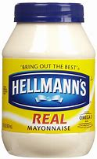
Fats & Oils: Emulsions
Emulsions are mixtures of liquids that do not normally mix (e.g. oil & water) because oil is hydrophobic (hates water).
Emulsifiers have a hydrophilic (water loving) end and a hydrophobic end. The hydrophilic end forms a chemical bond with the water, & the hydrophobic end forms a chemical bond with the oil.
Emulsified products include: mayonnaise & hollandaise.
Stabilisers prevent emulsions from separating.
Egg yolks contain lecithin, a natural emulsifier. Eggs help
Stabilise mayonaise

Slide 43
Fats & Oils Test
What term describes how fat makes a short texture product?
_____________________
The ability of a fat to change properties is known as plasticity, is this true or false? _________
Which basic cake making process traps air into the cake? _______________________
Which of these statements is NOT true?
A) shortening is a process that creates a hard texture in products.
B) shortening is seen in shortcrust pastry, shortbread biscuits, cookies & rich pastries.
C) the process in food preparation most likely to bring about shortening is the rubbing in method.

Slide 44
Fats & Oils Test cont………
Fats are used in food preparation to promote characteristic textures, flavours and colours. Identify the functional properties of fat in the preparation processes in the table:
Process | Function of Process | End Product Characteristic
Margarine & sugar beaten (creamed) together in a mixture | Explain TWO functions | Give TWO characteristics
Margarine or butter are rubbed together into a flour mixture | ONE function | ONE characteristic

Slide 45
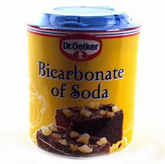
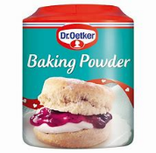
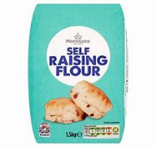
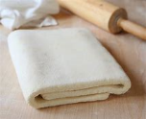
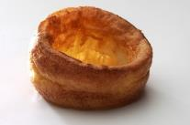
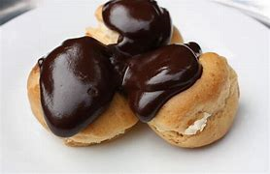
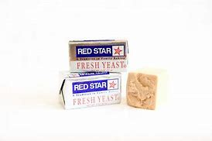
Memory challenge
Mechanical AIR is incorporated into a mixture, and hot air rises. Whisk & mix – meringue & cakes. Sieve – flour in cakes Folding and rolling – puff pastry Rubbing - scones | Chemical Carbon Dioxide (CO2) these ingredients produce of CO2 when heat and moisture are present: Bicarbonate of soda Baking powder SR Flour (SR flour is a correct mix of plain flour & Baking powder)
Raising Agents
Physical STEAM is produced from the liquid in a recipe – it has 1600 times the volume of water. It helps the following foods rise: Yorkshire pudding Profiteroles | Biological YEAST ferments to produce bubbles of Carbon Dioxide gas when mixed with moisture and oxygen.

Slide 46
Quick Test
What term describes how fat makes a short texture?
The ability of a fat to change properties is known as plasticity. Is this true or false?
Which basic cake making process traps air into cakes?
What is the raising agent in a whisked sponge cake?
What happens when air is heated?
How does egg white trap air?
How can water help make a mixture light during cooking?
Describe 3 functions of raising agents in raising agents:____________,
__________, _____________
Which raising agent is used in scones? _________________________

Slide 47
Test cont……….
What gas would the raising agent produce?_____________________
Explain how the raising agent works during baking?__________________________________________________________________________________________________________

Slide 48
Thickening
Modified starch
Gluten
Caramelise
Aerate
Denature
Use these key words to answer the following:
Many recipes work due to chemical reactions in food. Give examples of these and explain the reactions or changes which take place.

Slide 49
Cont………….
________________________________________________________________________________________________________________________________________________________________________________________________________________________________________________________________________________________________________________________________________________________________________________________________________________________________________________________________________________________________________________________________________________________________________________________________________________________________________

Slide 50
Food Science Homework
Make a batch of panckes.
Observe what happens as they cook.
Write about how you made the pancakes & explain in detail what happened as the cooked. Explain the science involved ☺
Take & print photos of each stage. Annotate the photos when explaining what’s happening during cooking ☺

