Slide 1
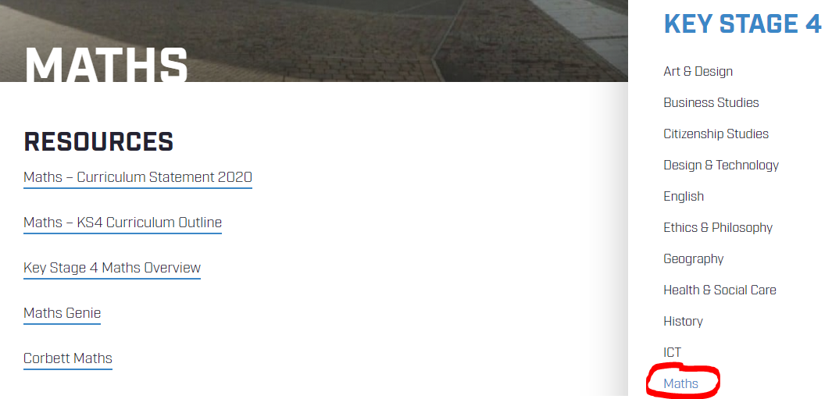
WEBSITE

Slide 2
CORBETT MATHS

Slide 3
MATHS GENIE

Slide 4
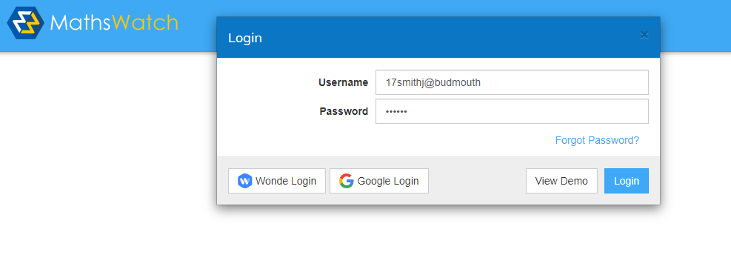
MATHSWATCH
17
surname
initial
@budmouth
BUD101

Slide 5
MATHSWATCH

Slide 6
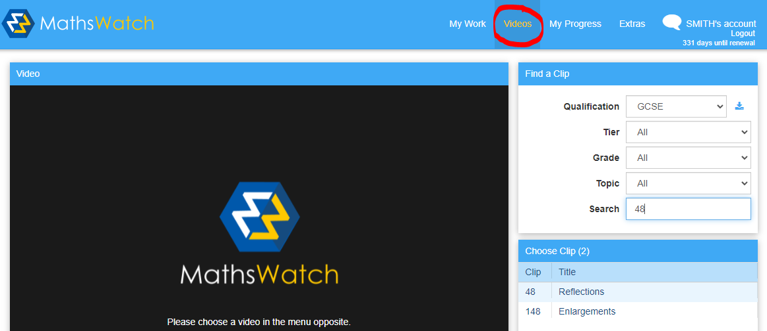
MATHSWATCH

Slide 7
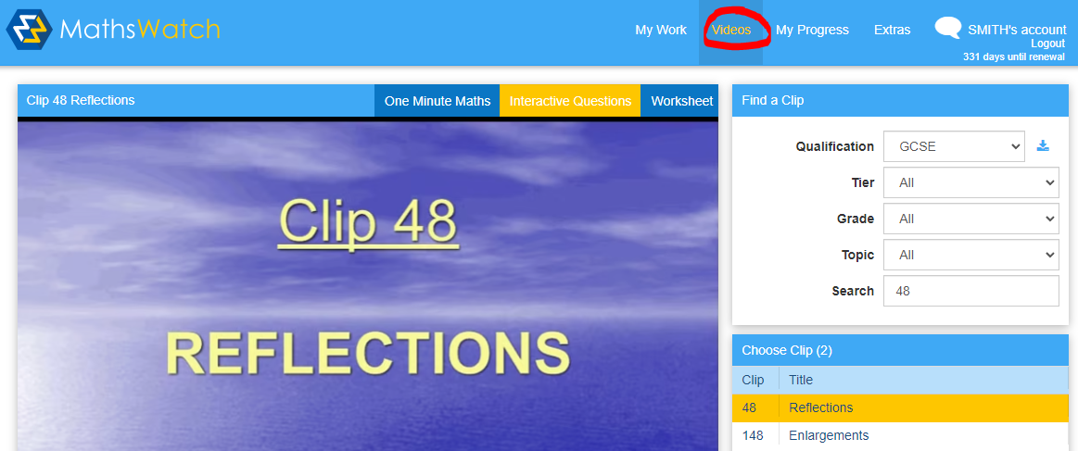
MATHSWATCH

Slide 8
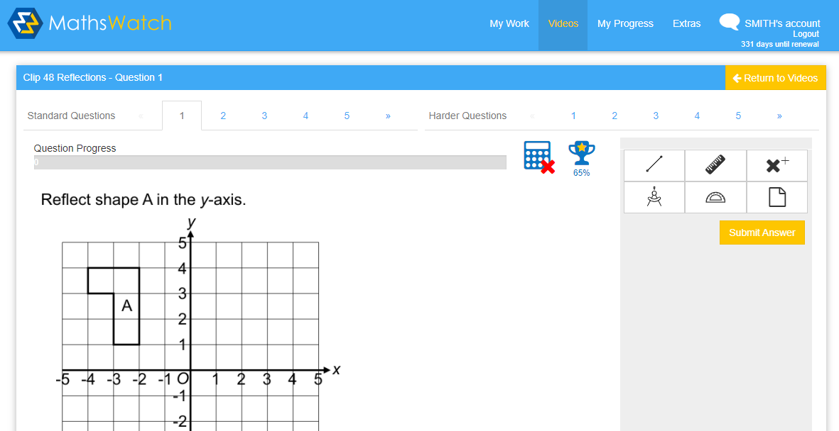
MATHSWATCH

Slide 9
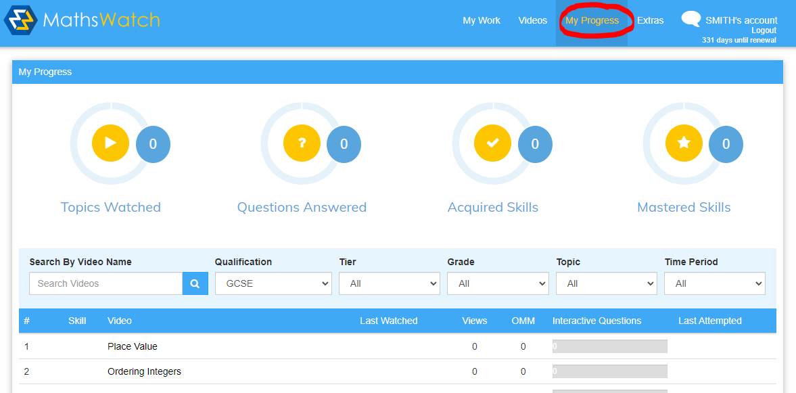
MATHSWATCH

Slide 10
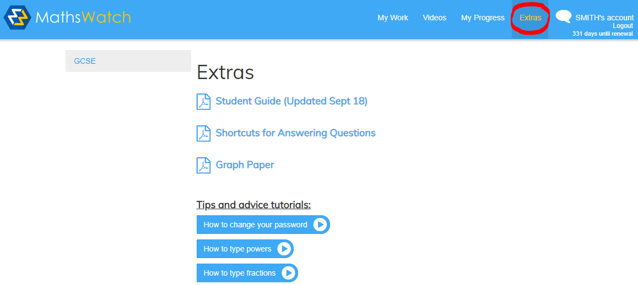
MATHSWATCH

Slide 11
REVISION + INTERVENTION
Tuesday!
Week 1: Intervention (Invite Only)
Week 2: Open Revision

Slide 12
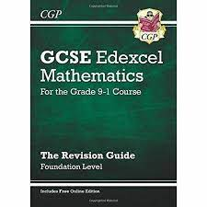
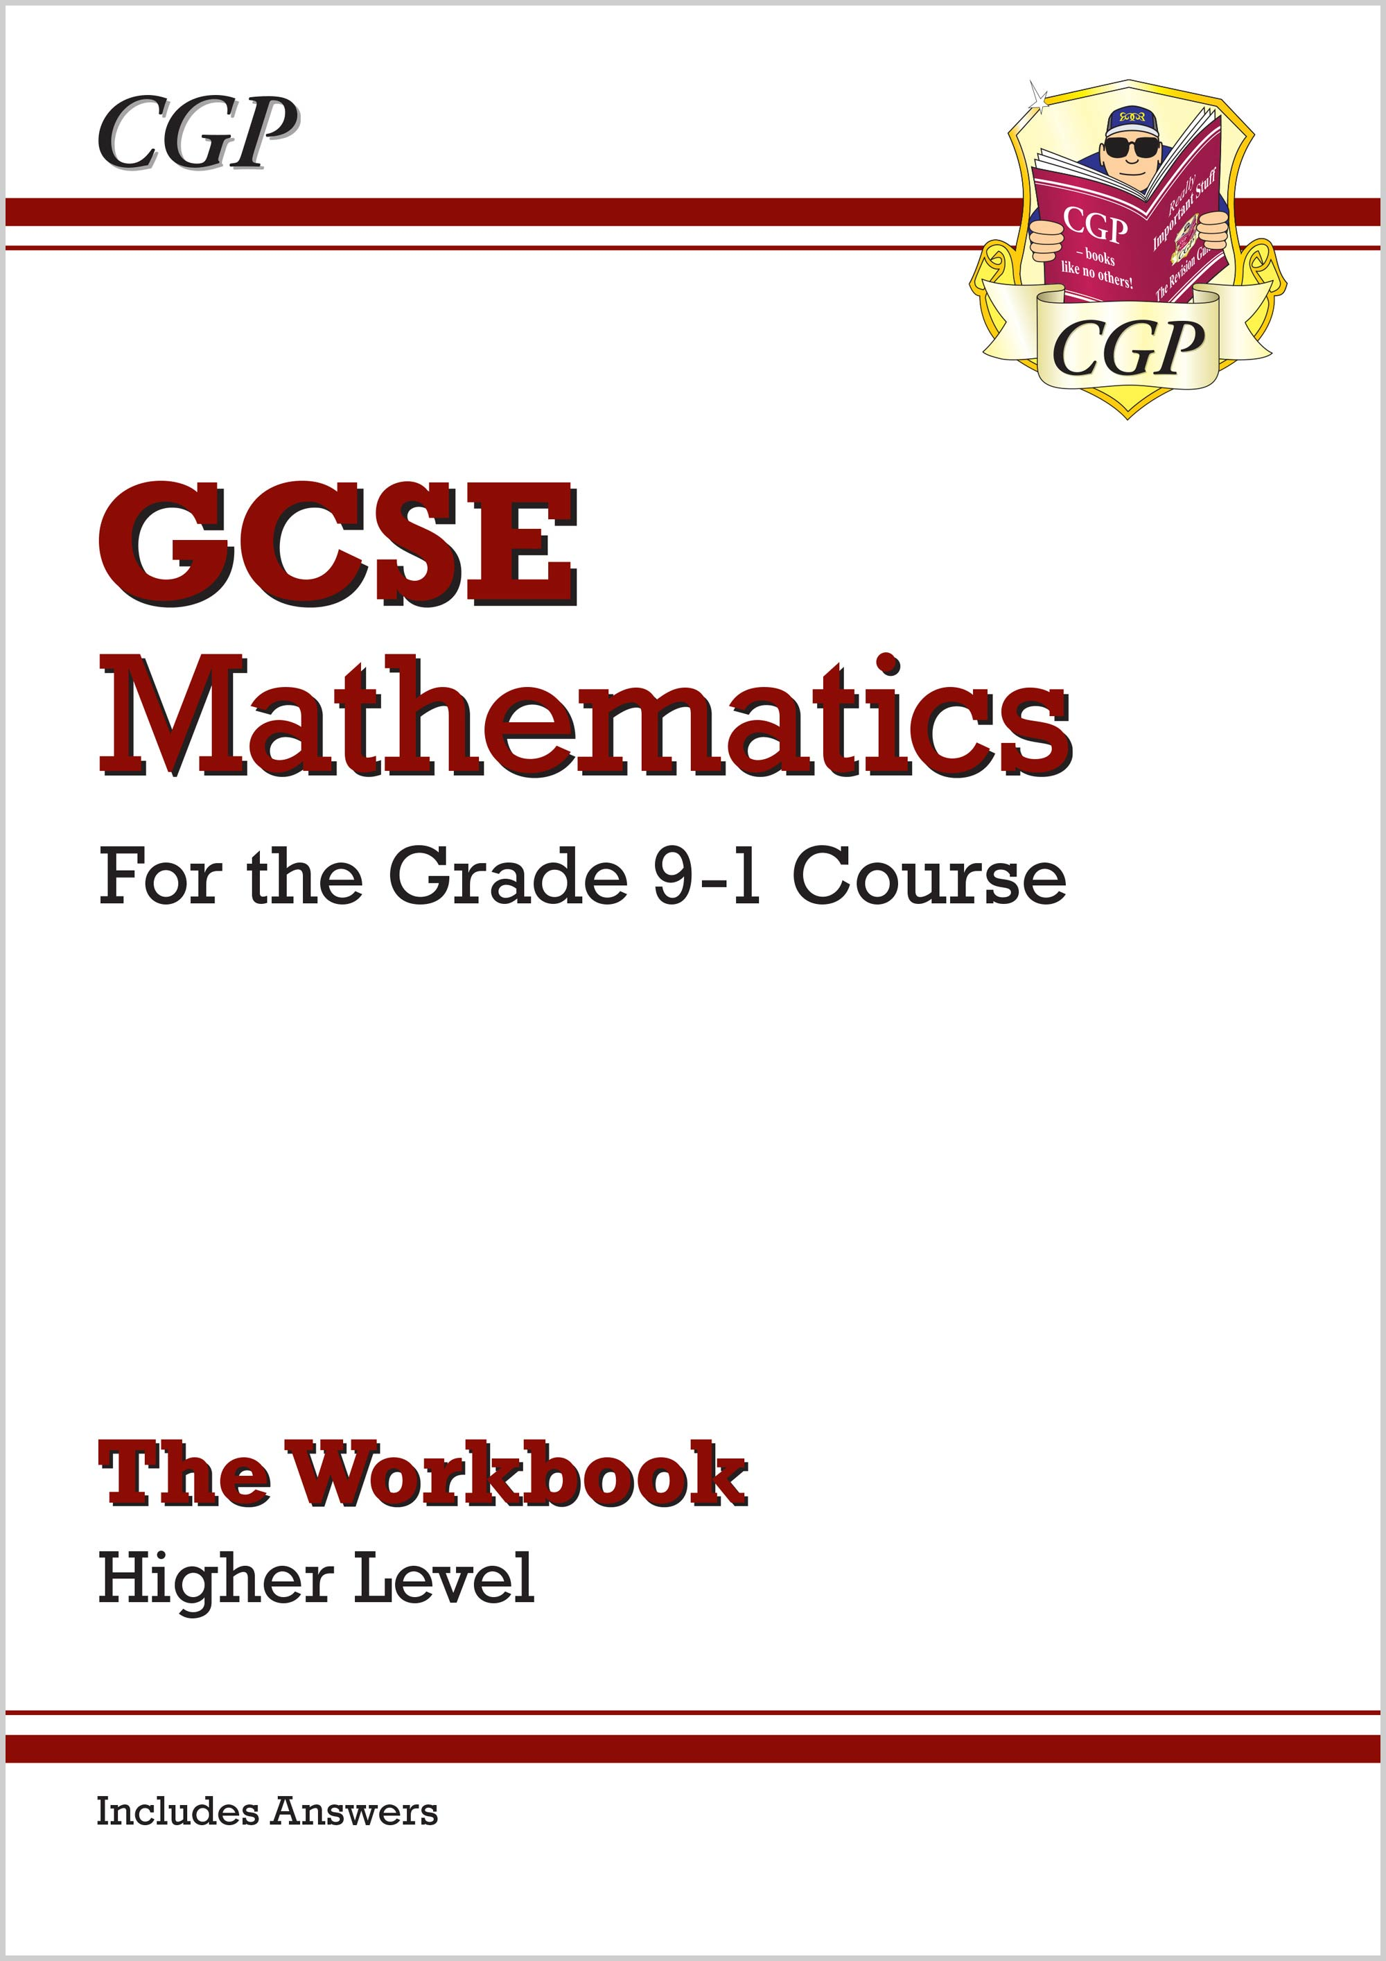
REVISON GUIDES

Slide 13
Mock + Real Exams
Paper 1: Non-Calculator
Paper 2/3: Calculator Allowed
Time allowed 1 ½ hours

Slide 14
Mock Exams
These start week beginning 8 Nov
Two exam papers
Paper 1 and Paper 2

Slide 15
Real Exams
Paper 1: 20May 2022 (before ½ term)
Paper 2: 07 June 2022 (after ½ term)
Paper 3: 13 June 2022

Slide 16
DEPARTMENT INPUT
Exam practice every two weeks
Immediate Feedback
DIRT tasks given in lessons
Homework
Opportunity to Improve scores

