Slide 1
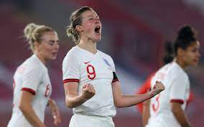
A-LEVEL PE
OCR
Pre-course Booklet
Student Name ___________
Submit to your A-Level PE teacher first week of September.
To help you gain a full understanding of what you will study during the A-Level PE, please click here for the course specification link.
lbugler@budmouth-aspirations.org Mrs Bugler for support

Slide 2
TASK 01|
Physiological Factors Affecting Performance
Research the terms below and complete the glossary. Once you have completed the written glossary, attempt to revise the key terms.
Key Term | Description and a sporting movement
Dorsi-flexion | Decreases joint angle bringing toes closer to the tibia (toes up). E.g preparing for jump shot in basketball.
Plantar-flexion
Medial rotation
Lateral rotation
Abduction
Adduction
Agonist muscle
Antagonist muscle
Fixator muscle
Concentric contraction
Eccentric contraction
Isometric contraction
Motor neuron
Action potential
Diastole (Cardiac cycle)
Systole (Cardiac cycle)

Slide 3
Key Term | Description
Vasomotor centre
Conduction system
Myogenic
Starling’s Law
Haemoglobin
Respiratory Control Centre
Partial pressure
Diffusion
Bohr Shift
Basal metabolic rate (BMR)
Thermic effect of food (TEF)
Metabolic equivalent value (MET)
Pharmacological aids
Recombinant erythropoietin (RhEPO)
Hyper-viscosity
Human growth hormone (HGH)
Muscle Hyperplasia
Proprioceptive neuromuscular facilitation (PNF)
Atherosclerosis
Free body diagram

Slide 4
TASK 02|
Psychological Factors Affecting Performance
Motor or movement skill is an action task that has a goal and requires voluntary body and/or limb movement to achieve the goal. Motor skills can be analysed and grouped together using a scale or continuum, considering their different characteristics.
Complete the tasks below to demonstrate your understanding of skill classification.
Difficulty Continuum Explain the difficulty continuum. _________________________________________________________ _________________________________________________________ _________________________________________________________ _________________________________________________________ _________________________________________________________ Using your favourite sport, plot three skills and justify your reasons in the space below. Simple Complex _________________________________________________________ Justification

Slide 5
TASK 02|
Psychological Factors Affecting Performance
Pacing Continuum Explain the pacing continuum. _________________________________________________________ _________________________________________________________ _________________________________________________________ _________________________________________________________ _________________________________________________________ Using your favourite sport, plot three skills and justify your reasons in the space below. Self-paced Externally-paced _________________________________________________________ Justification
Exam Style Question Considering the pacing continuum, the coach has placed performing a tennis serve as a self-paced skill. Justify his decision to classify the skill in this way (3 marks) _________________________________________________________ _________________________________________________________ _________________________________________________________ _________________________________________________________ _________________________________________________________ _________________________________________________________ _________________________________________________________ _________________________________________________________ _________________________________________________________ _________________________________________________________

Slide 6
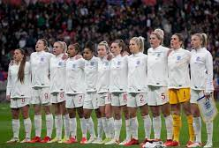
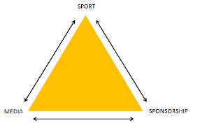
TASK 03|
Socio-cultural Issues in Physical Activity & Sport
The Lionesses are about to perform in the FIFA Women's World Cup 2023, entering as current UEFA European Champions. There is still a difference between men and women participation figures. Far more men get involved in sport, either to spectate or participate. Write a summary on why the recent success at the Euro’s have impacted female participation figures. Consider the golden triangle as a foundation for your writing.

Slide 7
TASK 4|
Non-exam Assessment | Performance in PE
Your own practical performances will be a factor towards your overall grade.
Write an essay (preferably handwritten) on your sporting background that includes the points included in the model below. It is a chance for you to show us your writing skills but is also helps us to support you in your choice of sport for your practical when you find it hard to choose!

Slide 8
TASK | Research
Rainy day - Here are some of the picks of the best films based on real life scientists, discoveries and athlete journeys. Consider some of the issues linked to these films that may feature in your A-Level learning. No need to write anything for this task.

